Slide 1





Real-time Analysis
MIRA AI Triage Platform
Instant patient vitals processing
Smart Classification
AI-driven severity assessment
Medical Intelligent Response Assistant
Efficient Triage
AI-powered platform designed to help hospitals classify and prioritize patients efficiently using configurable triage rules and intelligent decision systems.
Optimized resource allocation

Slide 2






The Challenge
Hospitals face major operational challenges
Overcrowded EDs
Staff Shortages
Emergency departments overwhelmed with patient volume
Insufficient medical professionals available
Delayed Identification
Inefficient Triage
Critical patients not identified quickly enough
Manual processes lead to poor resource allocation
These issues lead to slower treatment and poor resource allocation

Slide 3










Solution
MIRA AI Triage Platform
Process Flow
AI-assisted healthcare solution for intelligent patient management
Patient Vitals
AI Evaluation
Automatic Vitals Analysis
Data Input
Intelligent Analysis
Real-time patient vital sign processing
Severity Classification
Critical
Moderate
Stable
Severity Classification
Resource Allocation
Priority Level
Assignment
Resource Allocation
Automated workflow ensures faster and more accurate patient prioritization
Intelligent assignment of doctors and wards

Slide 4




Operational Workflow
1
2
3
4
5
Administrator Defines Rules
Patient Vitals Entered
AI Evaluates Condition
Patient Categorized
Dashboard Display
System assigns severity level: Critical, Moderate, or Stable
Manager views prioritized patient list with actionable insights
Admin configures triage classification logic using AI-powered rule engine
Manager inputs patient vital signs and symptoms into the system
AI models analyze patient data and apply triage rules
Configuration Phase
Data Input
AI Processing
Critical
Moderate
Stable
Action Phase

Slide 5
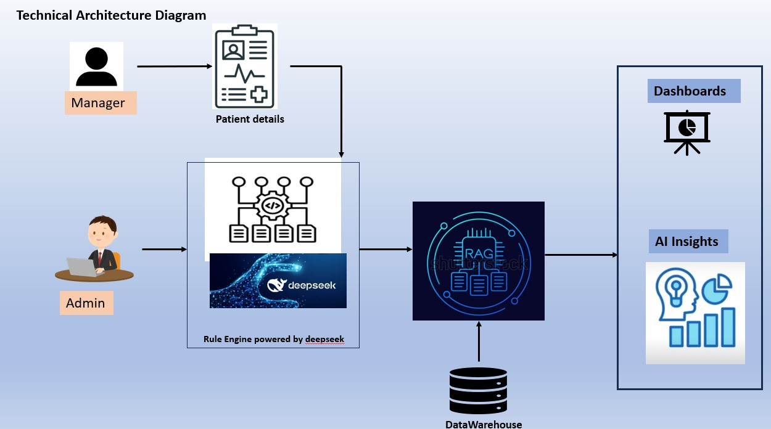
Architecture

Slide 6















Technology Stack
Frontend
Backend
AI Layer
React
FastAPI
GPT-4o
Modern component-based UI library
High-performance Python framework
Advanced reasoning & explanations
Tailwind CSS
SQLAlchemy
GPT-4o Mini
Utility-first styling framework
ORM for database operations
Fast inference & lightweight
Framer Motion
Pydantic
DeepSeek R1
Smooth animations & transitions
Data validation & settings
Structured reasoning engine
Recharts
SQLite
DeepSeek V3
Interactive data visualization
Lightweight embedded database
Analytical reasoning & insights

Slide 7
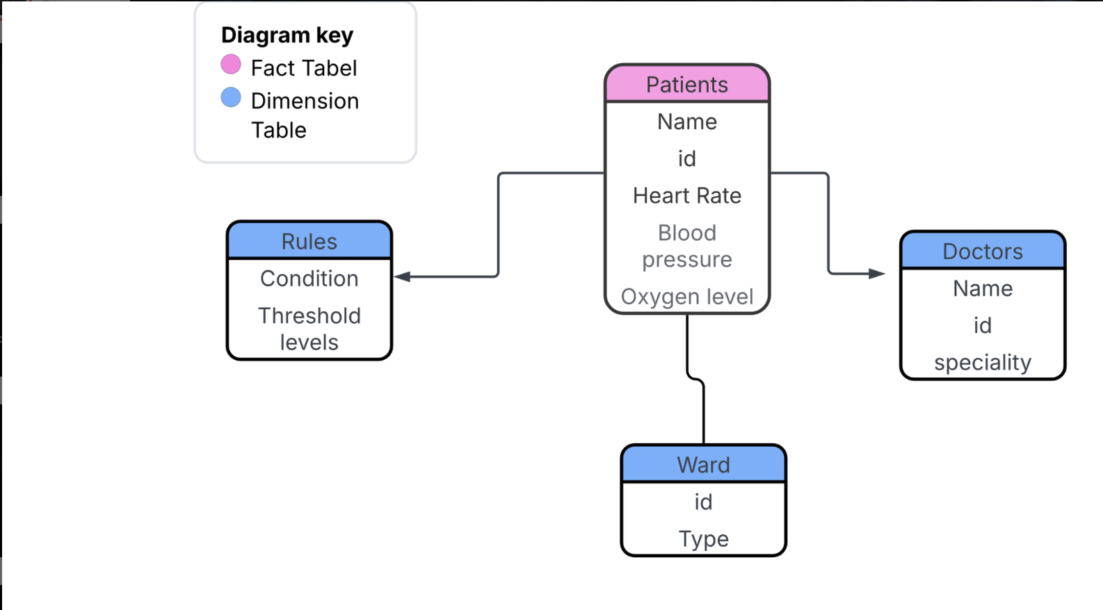
ER Diagram

Slide 8







AI Models Integration
GPT-4o
GPT-4o Mini
Advanced Reasoning
Fast & Efficient
Natural language reasoning
Lightweight inference
Multi-Model Strategy
Prompt interpretation
Quick response time
Structured output generation
Real-time dashboard insights
Different tasks require different AI strengths — reasoning, speed, or structured analysis.
Accuracy
DeepSeek R1
DeepSeek V3
Specialized models for each task
Structured Logic
Advanced Analysis
Performance
Optimized response times
Rule-based reasoning
Analytical reasoning
Scalability
Decision logic evaluation
Multi-step logic processing
Flexible architecture design
Symptom-to-ward mapping
Detailed clinical insights

Slide 9




Why & Where: Model Applications
DeepSeek V3
GPT-4o
Generate AI Insights
Create Rule from Prompt
Purpose:
Purpose:
Patient condition explanation & medical reasoning
Convert natural language into structured triage rules
Example Use Case:
Example Use Case:
"Patient classified as Critical due to low oxygen levels and elevated heart rate indicating respiratory distress."
"If oxygen level drops below 88 assign ICU" → Condition: oxygen < 88, Severity: Critical, Ward: ICU
DeepSeek R1
GPT-4o Mini
Assign Ward Based on Symptoms
Patient Insight in Monitor
Purpose:
Purpose:
Perform structured decision logic for patient placement
Quick AI explanations in Patient Monitor dashboard
Example Use Case:
Example Use Case:
Symptoms: Chest pain, Low oxygen, High heart rate → Severity: Critical, Ward: ICU, Doctor: Cardiologist
"Patient classified as Moderate because oxygen levels are stable but temperature is elevated indicating infection risk."

Slide 10
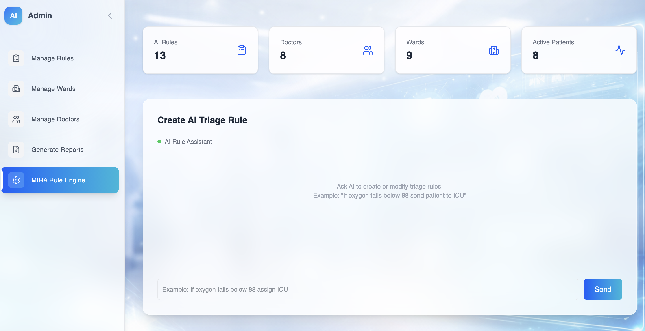




Administrator Portal
Admin Capabilities
Configure Triage Rules
AI-powered rule engine for intelligent classification logic
Manage Hospital Wards
Oversee ward assignments and resource allocation
Manage Doctors
Coordinate medical staff assignments and specializations
Export System Reports
Generate comprehensive analytics and operational data

Slide 11
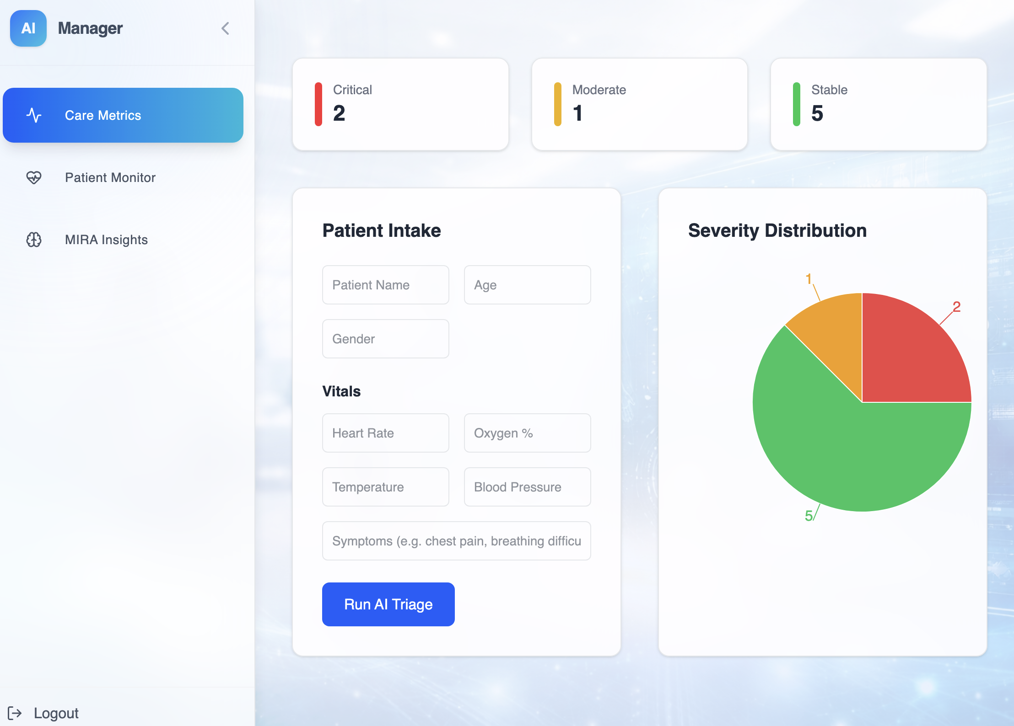




Manager Dashboard
Dashboard Features
Patient Intake Form
Enter patient vitals and symptoms for AI analysis
Triage Classification Results
AI-powered severity assessment and prioritization
Severity Distribution
Visual overview of patient priority levels
Real-time Monitoring
Track patient status and critical alerts

Slide 12
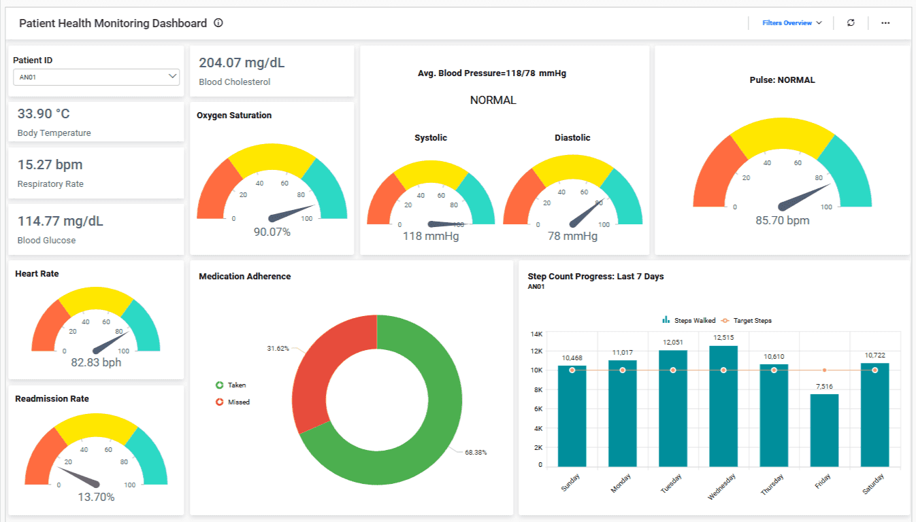


Key Benefits
Faster Patient Prioritization
AI-powered triage reduces decision time by 60%
Improved Resource Allocation
Intelligent assignment of doctors, wards, and equipment
Reduced Treatment Delays
Critical patients identified and treated faster
AI-Powered Insights
Clinical decision support for healthcare teams

Slide 13






Future Roadmap
EHR Integration
Predictive Risk Analysis
Electronic Health Records
Proactive Patient Management
Connect with existing hospital EHR systems for seamless patient data synchronization and comprehensive medical history access.
Identify patient risks before critical events occur using advanced AI predictive models and early warning indicators.
Phase 1 Implementation
AI Enhancement
AI Clinical Support
Real-time ICU Monitoring
Treatment Recommendations
Continuous Vital Signs
AI-powered clinical decision support providing treatment suggestions, drug interaction checks, and clinical alerts.
IoT-enabled continuous monitoring of ICU patients with real-time vital signs streaming and automated alerts.
Clinical Intelligence
IoT Integration

Slide 14




Live Demo
See MIRA in Action
AI Triage
Real-time Dashboard
Instant Classification
Experience real-time AI-powered patient classification and intelligent resource allocation

Slide 15




Thank You
Questions & Discussion
contact@mira-ai.health
www.mira-ai.health
Transforming Healthcare with AI-Powered Intelligence

